Slide 1
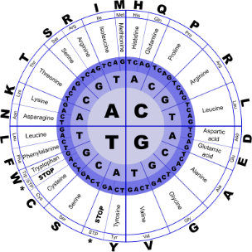
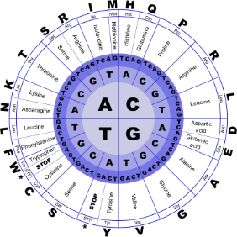


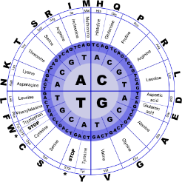
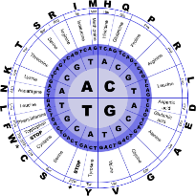
Fundamentals of Programming II
Search Sort

Slide 2
Introduction to Search Algorithms
Search: to locate a specific item in a list (array, vector, etc.) of information
Two algorithms (methods) considered here:
Linear search (also called Sequential Search)
Binary search

Slide 3
Linear Search Algorithm
Set found to false
Set position to –1
Set index to 0
While index < number of elts and found is false
If list [index] is equal to search value
found = true
position = index
End If
Add 1 to index
End While
Return position

Slide 4
Linear Search Algorithm
Array numlist contains
Searching for the the value 11, linear search examines 17, 23, 5, and 11
Searching for the the value 7, linear
search examines 17, 23, 5, 11, 2, 29, and 3
17 | 23 | 5 | 11 | 2 | 29 | 3

Slide 5
Linear Search Algorithm
Benefits
Easy algorithm to understand and to implement
Elements in array can be in any order
Disadvantage
Inefficient (slow): for array of N elements, it examines N/2 elements on average for a value that is found in the array, N elements for a value that is not in the array

Slide 6
Binary Search Algorithm
Divide a sorted array into three sections:
middle element
elements on one side of the middle element
elements on the other side of the middle element
If the middle element is the correct value, done. Otherwise, go to step 1, using only the half of the array that may contain the correct value.
Continue steps 1 and 2 until either the value is found or there are no more elements to examine.

Slide 7
Binary Search Algorithm
Array numlist2 contains
Searching for the the value 11, binary search examines 11 and stops
Searching for the the value 7, binary
search examines 11, 3, 5, and stops
2 | 3 | 5 | 11 | 17 | 23 | 29

Slide 8
Binary Search Algorithm
Benefit
Much more efficient than linear search. For an array of N elements, it performs at most
log₂N comparisons.
Disadvantage
Requires that array elements be sorted

Slide 9
Searching an Array of Objects
Search algorithms are not limited to arrays of integers
When searching an array of objects or structures, the value being searched for is a member of an object or structure, not the entire object or structure
Member in object/structure: key field
Value used in search: search key

Slide 10
Introduction to Sorting Algorithms
Sort: arrange values into an order
Alphabetical
Ascending (smallest to largest) numeric
Descending (largest to smallest) numeric
Two algorithms considered here
Bubble sort
Selection sort

Slide 11
Bubble Sort Algorithm
Compare 1st two elements and exchange them if they are out of order.
Move down one element and compare 2nd and 3rd elements. Exchange if necessary. Continue until the end of the array.
Pass through the array again, repeating the process and exchanging as necessary.
Repeat until a pass is made with no exchanges.

Slide 12
Bubble Sort Algorithm
Array numlist3 contains
17
23
5
11
First, compare values 17
and 23. In correct order,
so no exchange.
Finally, compare values
23 and 11. Not in correct
order, so exchange them.
Then, compare values
23 and 5. Not in correct
order, so exchange them.
9-12

Slide 13
Bubble Sort Algorithm
After first pass, array numlist3 contains
In order from previous pass
17
5
11
23
Compare values 17 and
5. Not in correct order,
so exchange them.
Compare values 17 and
23. In correct order, so
no exchange.
Compare values 17 and
11. Not in correct order,
so exchange them.
9-13
9-13

Slide 14
Bubble Sort Algorithm
After second pass, array numlist3 contains
In order from previous passes
5
11
17
23
Compare values 5 and
11. In correct order, so
no exchange.
Compare values 17 and
23. In correct order, so
no exchange.
Compare values 11 and
17. In correct order, so
no exchange.
No exchanges, so
array is in order
9-14
9-14
9-14

Slide 15
Bubble Sort Algorithm
Benefit
Easy to understand and to implement
Disadvantage
Inefficiency makes it slow for large arrays
9-15
9-15
9-15

Slide 16
Selection Sort Algorithm
Locate smallest element in array and exchange it with element in position 0.
Locate next smallest element in array and exchange it with element in position 1.
Continue until all elements are in order.
9-16
9-16
9-16

Slide 17
Selection Sort Algorithm
Array numlist contains
Smallest element is 2. Exchange 2 with
element in 1st array position (i.e., element 0).
11 | 2 | 29 | 3
Now in order
2 | 11 | 29 | 3
9-17
9-17
9-17
9-17

Slide 18
Selection Sort Algorithm
Next smallest element is 3. Exchange
3 with element in 2nd array position.
Next smallest element is 11. Exchange
11 with element in 3rd array position.
Now in order
2 | 3 | 29 | 11
Now in order
2 | 3 | 11 | 29
9-18
9-18
9-18
9-18
9-18

Slide 19
Selection Sort Algorithm
Benefit
More efficient than Bubble Sort, due to fewer exchanges
Disadvantage
Considered harder than Bubble Sort to understand and implement
9-19
9-19
9-19
9-19
9-19

Slide 20
Sorting an Array of Objects
As with searching, arrays to be sorted can contain objects or structures
The key field determines how the structures or objects will be ordered
When exchanging the contents of array elements, entire structures or objects must be exchanged, not just the key fields in the structures or objects
9-20
9-20
9-20
9-20
9-20

Slide 21
Sorting and Searching Vectors
Sorting and searching algorithms can be applied to vectors as well as to arrays
Need slight modifications to functions to use vector arguments
vector <type> & used in prototype
No need to indicate vector size, as functions can use size member function to calculate
9-21
9-21
9-21
9-21
9-21

Slide 22
Complexity Example
Find the largest value in array A of size n
biggest = A[0]
indx = 0
while (indx < n) do
if (A[n] > biggest)
then
biggest = A[n]
end if
end while
Analysis:
Lines 1 and 2 execute once.
The test in line 3 executes n times.
The test in line 4 executes n times.
The assignment in line 6 executes at most n times.
Due to lines 3 and 4, the algorithm requires execution time proportional to n.
9-22
9-22
9-22
9-22
9-22
9-22

